Slide 1
Google BigQuery
Johannes Ahlmann
johannes@sensatus.io

Slide 2
Agenda
Why BigQuery
Use Cases
Architecture
Alternatives
Demo Time
(Material available on GH codinguncut/talks)

Slide 3
Use Cases
bigquery-public-data:
crypto_bitcoin (1.1TB)
crypto_ethereum (1.4TB)
github_repos (3.7TB source code)
fh-bigquery:
wikipedia_v3 (11TB pageviews)
reddit_comments (1.8TB)
reddit_extracts (5.6TB)
wikidata (3.5TB)
pypi (20TB package installs)
stackoverflow (5.2TB)
stackoverflow_archive (2TB)
wikidata (3.5TB)
SELECT sum(size_bytes)/pow(10,12) as size
FROM `<dataset>.__TABLES__`;
gdelt-bq:gdeltv2 (79TB)
githubarchive:day (6TB)
httparchive:latest (27.5TB)

Slide 4





Input Data Formats

Slide 5




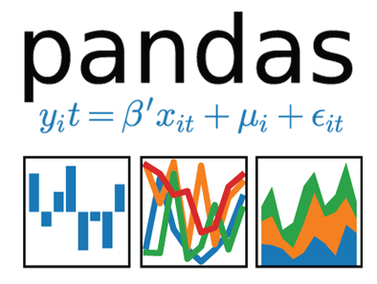




Data Sources
Google
Cloud Storage

Slide 6
Dremel
Dremel: Interactive Analysis of Web-Scale Datasets
Interactive ad-hoc query system for in-situ nested data, near-realtime
Inspiration for Apache Drill, Apache Impala
Columnar
1s Query Planning
Query Execution
Strongly-typed nested records
MR ~ minutes to hours, Dremel ~ seconds
Cost
$5 / TB processed
active storage - $0.02/ GB/ month
long-term storage (90 days) $0.01 /GB/ month

Slide 7
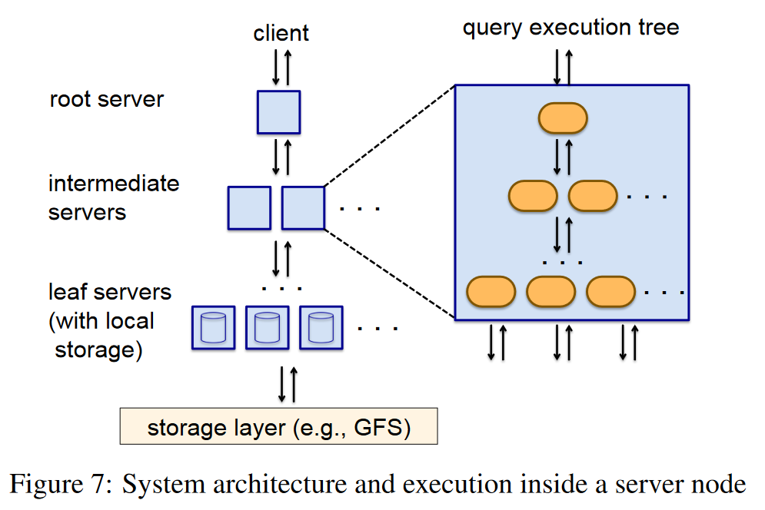
Query Execution

Slide 8
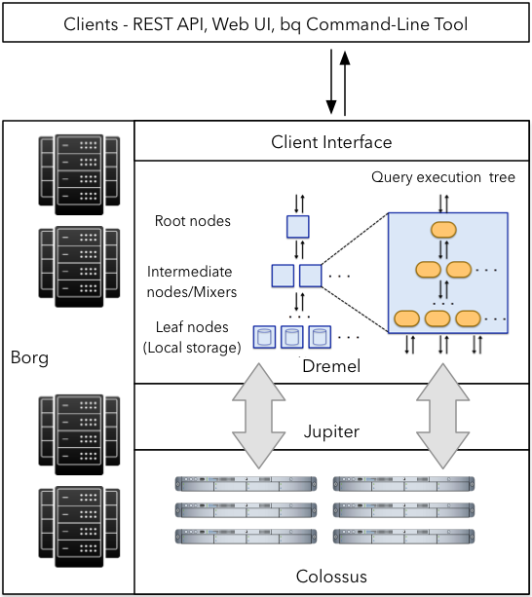
Architecture

Slide 9
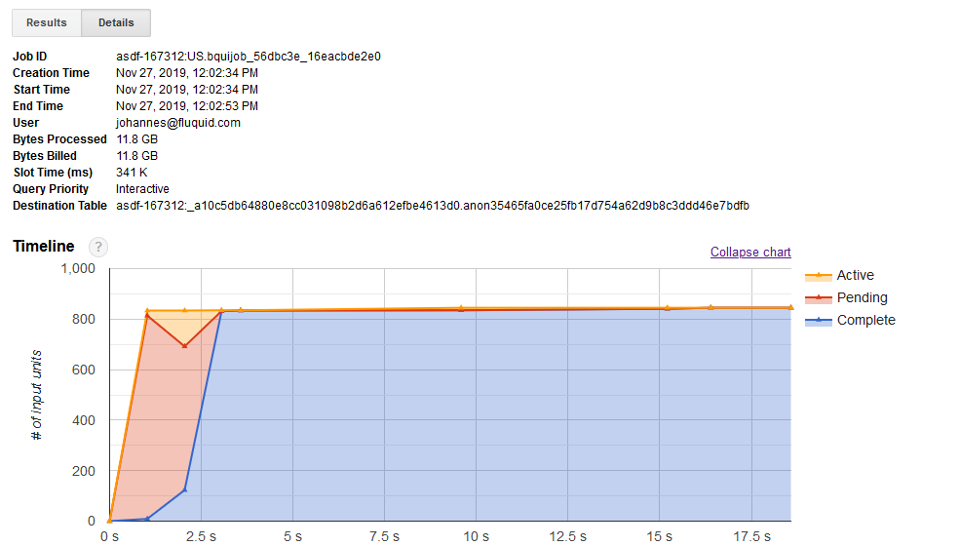

Slide 10






Alternatives
Postgres
Presto

Slide 11
Demo Time

